Slide 1
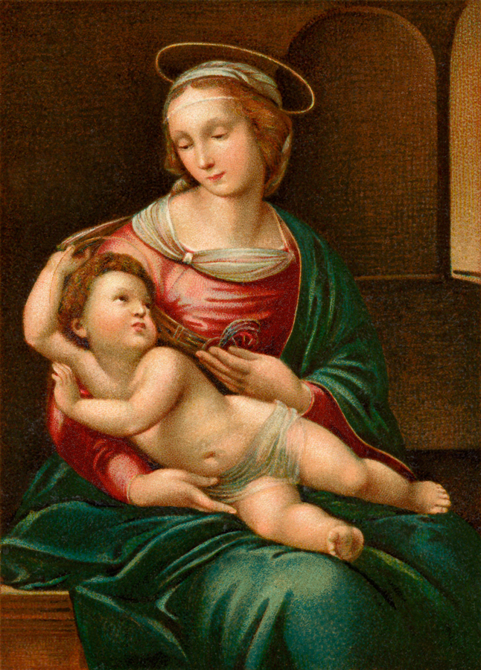
May is the Month of Mary
There is Catholic practice of assigning a special devotion to each month. May is the month where we remember Jesus’ mother Mary.

Slide 2
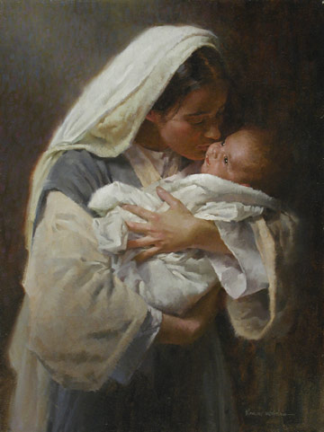
There are many images of Mary as a new mother with Jesus

Slide 3
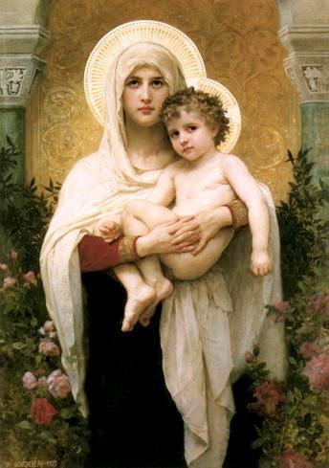
Over the centuries artists have drawn painted and sculptured Mary and Jesus in many different forms

Slide 4
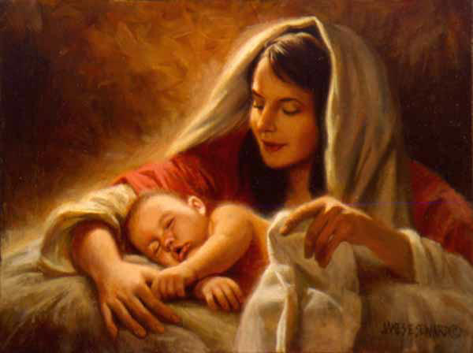

Slide 5
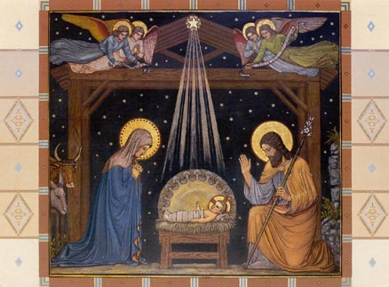

Slide 6
What do we actually know about Mary?

Slide 7
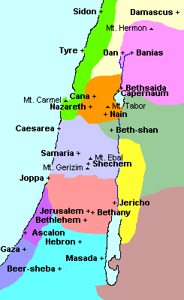
Mary was a young Jewish woman who
lived in Nazareth
in what
is now Israel

Slide 8
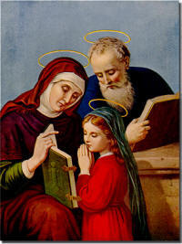
Mary’s parents are Anne and Joachim..

Slide 9
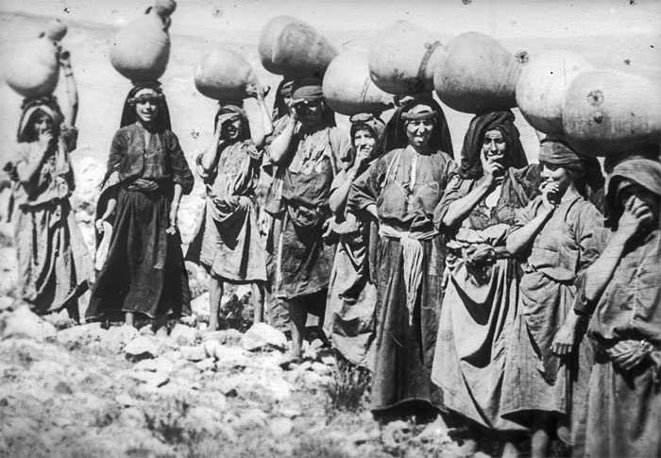
Mary was probably a peasant. Life in a rural village would have been filled with hard work in caring for the home. Woman were not educated.

Slide 10
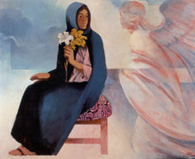
Mary was living in the town of
Nazareth when she received a very special visitor. God’s messenger, the angel Gabriel, came to
Mary! Gabriel said,
“Hail, favoured one! The Lord is with you.
God has found favour with you.
You will be the mother of Jesus, the Son of the
Most
High.” Mary responded by saying yes!

Slide 11
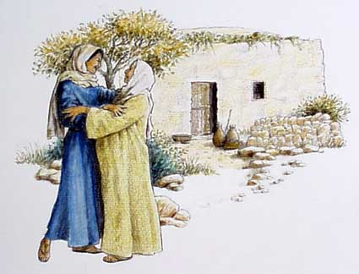
Mary’s cousin
Elizabeth was also going to have a baby.
Mary went on a difficult journey to see her.
Elizabeth’s son would grow up to be John the Baptist,
.
As soon as Elizabeth heard Mary’s voice, she cried out, “Most blessed are you among women and blessed is the fruit of your womb!” Elizabeth called

Slide 12
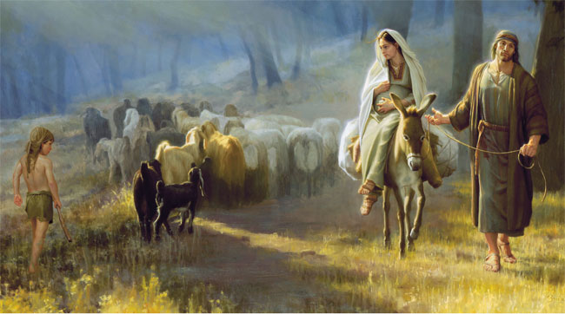
Joseph and Mary were married and when it came time to have the baby they travelled to Bethlehem

Slide 13
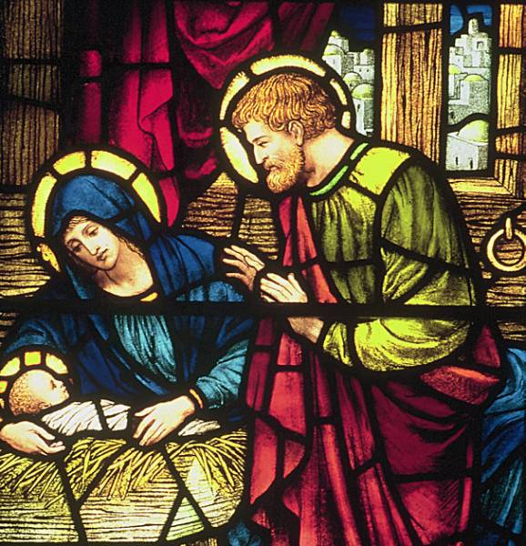
Jesus was born in a stable.
Mary wrapped him in warm clothes and laid him in a manger.

Slide 14
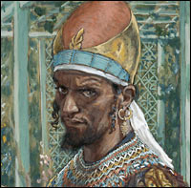
King Herod heard that a child had been born to a Jewish couple from the family of David. Herod was worried that this new king would challenge his authority. Because Herod couldn’t find Jesus, he ordered that all boys two years old and younger be killed.

Slide 15
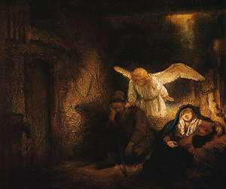
An angel of God appeared to Joseph in a dream and warned him of what was happening.
The Holy Family escaped to Egypt.

Slide 16
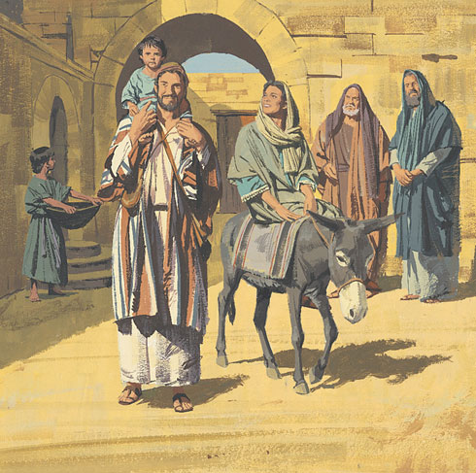
Mary, Joseph and Jesus stayed in Egypt until Herod died. And they returned to Nazareth

Slide 17
Mary knew what it was like to fear for her child’s safety

Slide 18
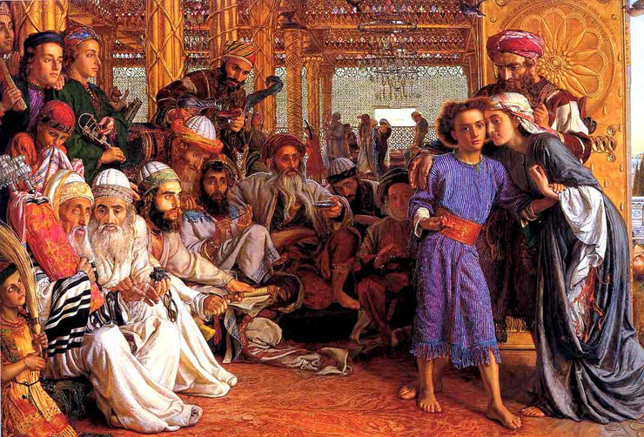
When Jesus was 12 years old,
Mary and Joseph travelled with him to the holy city of
Jerusalem for Passover. On their way back to Nazareth they discovered that he was missing. They returned to
Jerusalem to look for him, and after three days they found him in the Temple.

Slide 19
Mary and Joseph found a stable to stay in. There, Jesus
was born. Mary wrapped him in warm clothes and laid him
in a manger.

Slide 20
Mary believed in Jesus

Slide 21
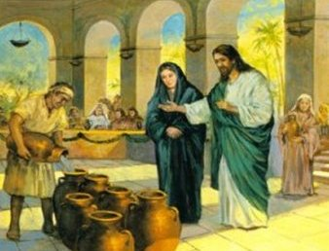
Jesus’ public ministry begins with a miracle at the wedding of friends.
In the course of the celebration, the hosts began to run out of wine.
Mary, knowing the hosts would be embarrassed in front of their guests, tells Jesus, “They have no wine.” Jesus says “Woman, how does your concern affect me? My hour has not yet come.”
But Mary knew the good in Jesus’ heart and his love for others would not let their friends be embarrassed. So she told the servants,
“Do whatever he tells you.” Jesus asked for jars filled with water and then changed the water into wine.

Slide 22
Mary knew grief

Slide 23
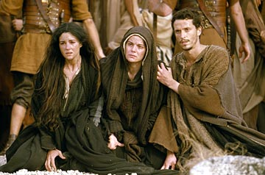
John’s gospel tells us that Mary was at he foot of the cross when Jesus was crucified and died. Before he died,
Jesus saw his mother with the disciple
John, whom he loved. He asked Mary to watch over John as a mother. Then Jesus asked the disciple to take care of his mother, and “from that hour the disciple took her into his home.”

Slide 24
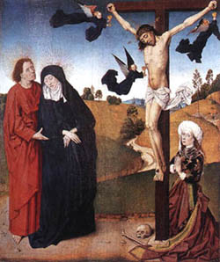
There are many images of Mary at the Cross

Slide 25
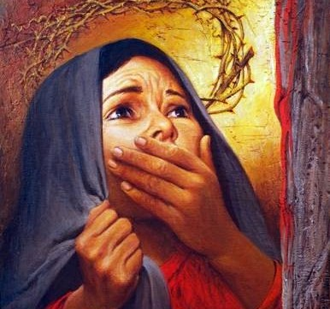
Mary
Knew what it was to go through difficult times. When times are difficult for you, she can be turned to in prayer

Slide 26
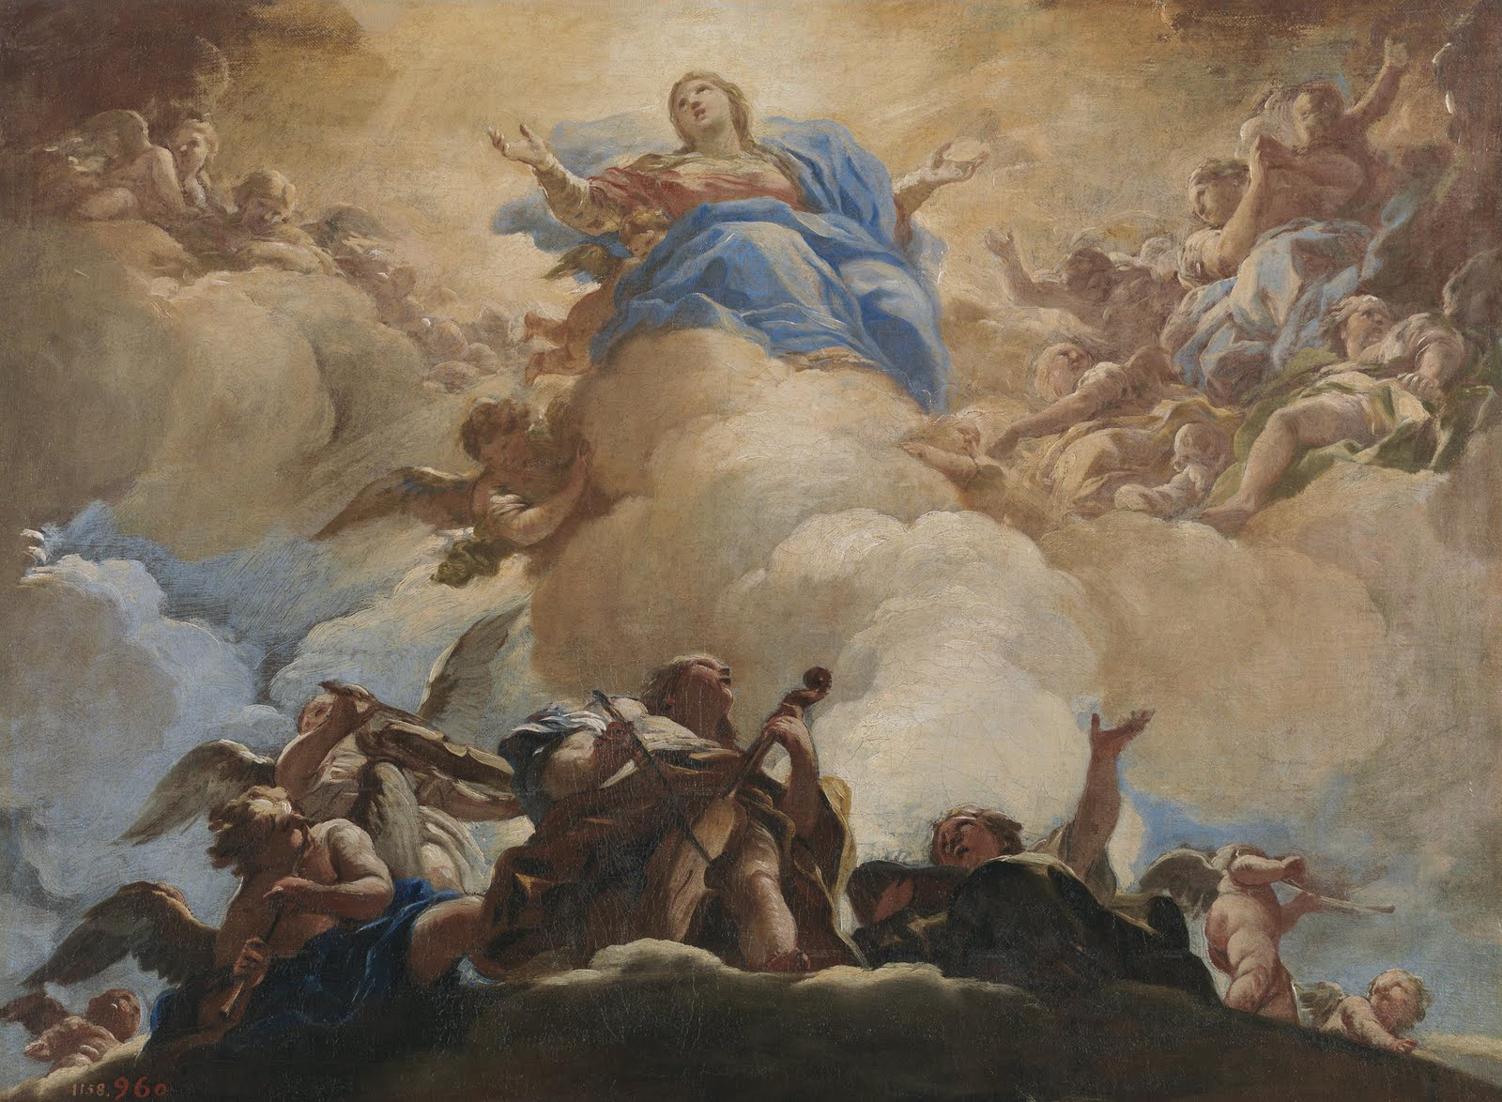
Assumption
Through Church tradition, we believe that when Mary’s life on earth was complete, she was assumed, or taken, body and soul into heaven.

Slide 27
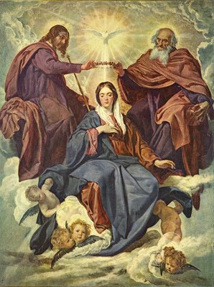
This particular picture shows Mary going up into Heaven. The church calls this her Assumption into heaven. The church celebrates this each year.

Slide 28
Jesus, may your mother, Mary, pray
for us and guide us on our journey
home to you.

Slide 29
MAY IS THE MONTH OF MARY
Mary is the mother of Jesus.
Mary is also called the mother of the Church.
What was so special about Mary that God asked her to be the mother of Jesus Christ?

Slide 30
Think of the nicest person that you know and think of some words to describe that person.

Slide 31
Mary is like the nicest person ever.

Slide 32
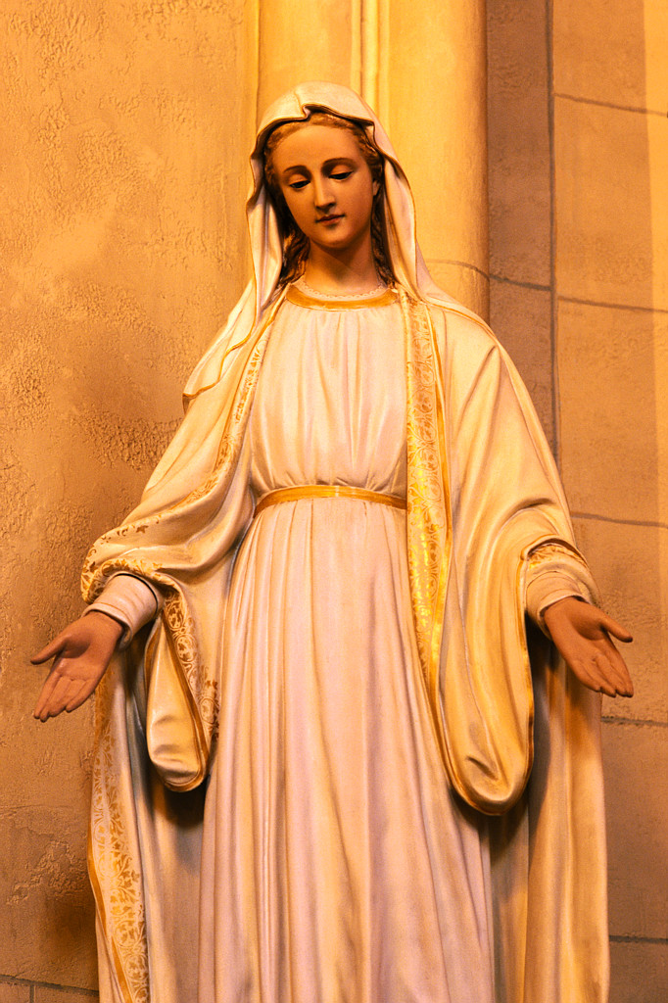
There are many statues around the word that show Mary.

Slide 33
Jesus, may your mother, Mary, pray
for us and guide us on our journey
home to you.

Slide 34
Hail Mary, full of grace.
Our Lord is with you.
Blessed are you among women,
and blessed is the fruit of your womb,
Jesus.
Holy Mary, Mother of God,
pray for us sinners,
now and at the hour of our death.
Amen.

Slide 35
